Slide 1

INSTITUTE :UIE
DEPARTMENT: ALL ACADEMIC UNITS
Bachelor of Engineering (All Sections)
Subject Name and Code:
Engineering Physics 23SPH-141
Prepared by: Dr. Anjana Sharma, Assistant Prof. Physics
CRYSTALLOGRAPHY & ULTRASONICS
DISCOVER . LEARN . EMPOWER

Slide 2
COURSE OBJECTIVES
The course is designed to make the students industry ready to contribute in the growing demand of the industry at local, national and international level.
It will make the students competent to understand basic concepts and applications of advanced engineering physics and apply its principles in their respective fields at global platform.
It will enhance the skill level of the students and shall make them preferred choice for getting employment in industry and research labs.
It will give thorough knowledge of the discipline to enable students to disseminate knowledge in pursuing excellence in academic areas.

Slide 3

COURSE OUTCOMES
CO Number | Title On completion of this course, the students are expected to learn | Level
CO1 | Quote the basic fundamental concepts of lasers, optical fibres, crystallography, ultrasonic oscillations, semiconductor physics, quantum mechanics and nanotechnology. | Remember, Understand
CO2 | Demonstrate the working of various lasers, fibre components, semiconductor devices; explain the behaviour of crystalline solids, quantum and nano-scale systems. | Understand
CO3 | Solve problems by applying principles related to lasers, fibres, semiconductors, oscillations, quantum and nanoscience. | Applying
CO4 | Compare various lasers and fibres, semiconducting devices, crystalline materials, structures at quantum and nanoscale on the basis of their properties for industrial applications. | Analyze
CO5 | Develop various systems using lasers, fibres, semiconductors and nanomaterials for futuristic applications. | Design
Fig. 1 Introduction [1]

Slide 4
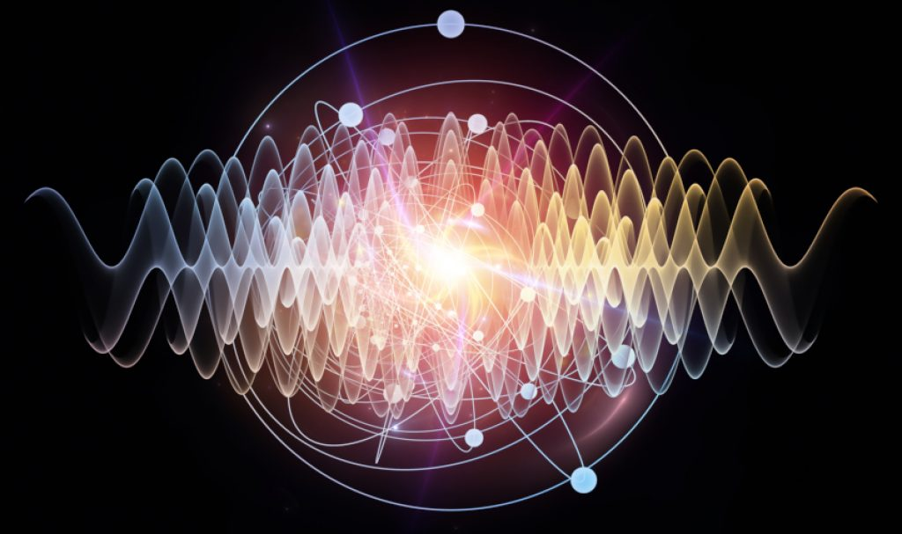
ULTRASONIC WAVES AND ITS PROPERTIES
Ultrasonic waves are sound waves transmitted above the human-detectable frequency range, usually above 20,000 Hz.
Figure 2 Ultrasonics [1]

Slide 5
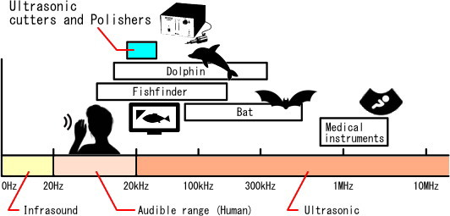
ULTRASONIC WAVES
Figure 3 Range of ultrasonics [2]

Slide 6
INTRODUCTION OF ULTRASONIC WAVES
The word ultrasonic combines the Latin roots ultra, meaning ‘beyond’ and sonic, or sound.
The sound waves having frequencies above the audible range i.e. above 20000Hz are called ultrasonic waves.
Generally these waves are called as high frequency waves.
The field of ultrasonic have applications for imaging, detection and navigation.
The broad sectors of society that regularly apply ultrasonic technology are the medical community, industry, the military and private citizens.

Slide 7
PROPERTIES OF ULTRASONIC WAVES
The ultrasonic waves cannot travel through vacuum.
These waves travel with speed of sound in a given medium.
Their velocity remains constant in homogeneous media.
These waves can weld certain plastics, metals etc.
These can produce vibrations in low viscosity liquids.
The ultrasonic waves are reflected and refracted just like light waves.
The speed of ultrasonic waves/acoustic waves is more in more dense media i.e. V_{g} < V_{l} < V_{s}. If ultrasonic waves enter from rarer medium to dense medium, then V₁ < V₂ so equation gives sin i / sin r < 1 => i<r. Thus ultrasonic waves will bend away from normal.

Slide 8
APPLICATIONS
Ultrasonic flaw detection.
Cutting and matching hard material.
Ultrasonic soldering and welding.
Measurement of flow devices.
Thermal effect.
It is used in sound navigation system.

Slide 9
SUMMARY
Introduction to Ultrasonic Wave
Properties of Ultrasonic Waves
Application

Slide 10
FAQS
How ultrasonic waves are generated?
What are Ultrasonic Waves?
What is inverse piezoelectric method?

Slide 11
REFERENCES
[1] https://www.omegasonics.com/ultrasonic-cleaning-2/how-ultrasonic-waves-produced/
[2] https://technopolitics.org/hacking-with-ultrasonic-waves/
[3] sonotec.com/en/column/ultrasonic.html
[4] https://en.wikipedia.org/wiki/Ultrasound
[5] https://www.britannica.com/science/ultrasonics
[6] https://physicstoday.scitation.org/doi/10.1063/1.1580055
[7] https://www.youtube.com/watch?v=yZty_W8ySng
[8] https://byjus.com/physics/applications-ultrasound/
[9] https://www.amazon.in/Fundamentals-Applications-Ultrasonic-Waves-Cheeke-ebook/dp/B078N6C56Y
[10] http://epgp.inflibnet.ac.in/epgpdata/uploads/epgp_content/S000015FT/P000068/M000150/ET/146166205610et.pdf
[11] http://hyperphysics.phy-astr.gsu.edu/hbase/Sound/usound.html

Slide 12
THANK YOU
For queries
Email: anjana.e1643@cumail.in

